Slide 1
Vehicle Alarm System
Presented By: Saddam Hussain

Slide 2
Introduction
Vehicle Alarm System is used to avoid road accidents. if we install this system in a vehicle and the distance between this vehicle is close to another vehicle it will beep the driver that the distance is less and slow down the vehicle. If the distance becomes less then the beep sound becomes higher. It means that distance is proportional to sound. And the other thing in this system is if the distance between the vehicles become less then First LED blink and when the distance becomes more less the other LED blink respectively and so on.

Slide 3
Components
Arduino Nano
Ultrasonic Sensor
Breadboard
Buzzer
Resistor
Male to Male Jumper Wire
Male to Female Jumper Wire
LED’s
USB Cable

Slide 4
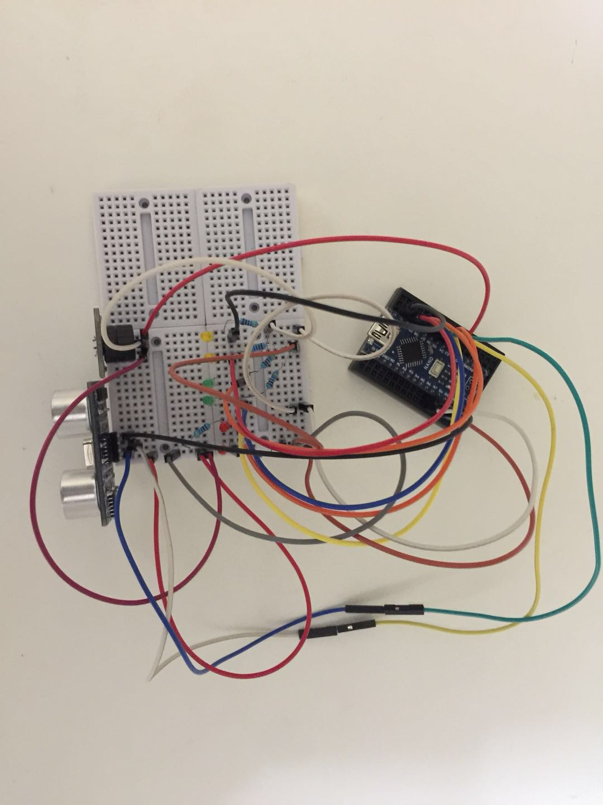
Circuit

Slide 5
Thanks

